Slide 1
Social accountability
F O R B A R A N G A Y S
ANSA EAP Operations Team
Orientation for Barangay Officials from Sta. Mesa
10 April 2010, Ateneo School of Government

Slide 2
Introductions:
Name, barangay or organization, position
Something that no one else in the room knows about you
What are you bringing to the workshop?
What do you wish to bring home from the workshop?

Slide 3
Suggested learning objectives:
To describe our idea or vision of good governance and relate it to our work in the barangay;
2. To explain how social accountability contributes to achieving good barangay governance;
3. To translate lessons into plans or actions to improve the enabling environment and mechanisms for social accountability in the barangay.

Slide 4
Suggested process:
10.00 – 10.30 Introductions and preliminaries
10.30 – 11.30 Workshop 1: Our idea of good governance
11.30 – 12.00 Social accountability for good barangay governance
12.00 – 13.00 LUNCH BREAK
13.00 – 13.30 Reflection/Plenary discussion
13.30 – 14.30 Workshop 2: What we have now?/What we can improve?
14.30 – 15.00 Sharing of action points, synthesis and closing

Slide 5
Workshop 1: Describing our idea or vision of good governance

Slide 6
What to you is good governance in the barangay?
Write your answer on an idea card. Maximum of 3 lines per card. Write in large, bold letters. Then tape your idea card on your chest.
Stand up, go around the room, and read each other’s idea card.
If you see an idea card(s) that you think is similar to what you have, group together. Choose a “champion” in your group. Look for a place where you can converse and deepen your insights. Be sure everybody in the group participates.
Write on an easel sheet the highlights of your conversation. Then report to the big group.

Slide 7
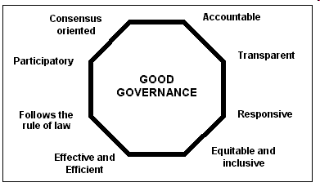
The United Nations defines 8 characteristics of good governance:

Slide 8
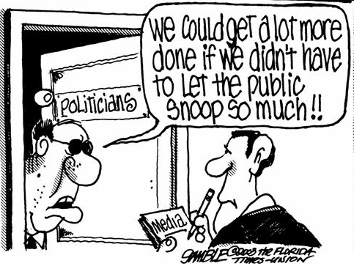
T
Transparency
Decision-making and enforcement follow set rules and regulations
Information is freely available for those who will be affected by decisions
Information is adequate, relevant, easily understandable

Slide 9
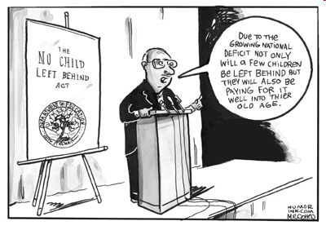
T
A
Accountability
Those in power should be answerable to those who will be affected by their decisions or actions
They should also be responsive to the needs of citizens from whom their power is derived

Slide 10
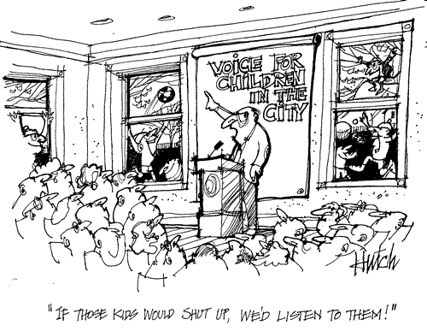
Involvement of citizens in decision-making and in efforts to improve their conditions
Citizens should have freedom to associate, capacitate themselves, and express their interests and views
T
A
P
Participation

Slide 11
T
Transparency
A
=
Accountability
GOOD GOVERNANCE
P
Participation

Slide 12
LEGAL and POLICY FRAMEWORK FOR TAP:
Philippine Constitution of 1987
Bill of Rights, Section 7
Right of people to information
Access to official records shall be afforded the citizen

Slide 13
Republic Act No. 6713
Code Of Conduct And Ethical Standards For Public Officials And Employees
Public officials and employees shall at all times be accountable to the people
All public officials and employees are obliged to submit annual performance reports which shall be open and available to the public

Slide 14
1991 Local Government Code of the Philippines
Decentralization
Establishment in every LGU of an accountable, efficient, and dynamic governance structure that will meet priority needs of its communities.

Slide 15
Local mechanisms for citizen participation:
Local initiative and referendum
CSO participation in local development councils and special bodies:
Local Health Board
Local School Board
Local Peace and Order Council
Local PBAC
Other optional bodies

Slide 16
Other participatory governance mechanisms:
1992 National Integrated Protected Areas Act
(protected area management board)
1997 Indigenous People’s Rights Act
(ancestral domain management board)
1998 Agricultural and Fisheries Modernization Act (fisheries/agricultural resources management board)

Slide 17
In 1996, a coalition of civil society organizations embarked on a Participatory Local Governance (PLG) or Barangay Training and Management (Batman) Project with support from Ford Foundation
The project was conducted in 877 barangays
Post project study of results in (2002) 14 PLG barangays that have approved BDP and 14 non-PLG barangays
Among the assessment criteria: TAP

Slide 18
Findings
Magno, Francisco (2002). Participatory Local Governance and the Protection of Vulnerable Sectors
Barangay development plans are not only more comprehensive but also more feasible
Increased level of awareness among citizens of the role and responsibilities of barangay officials
Openness and levelling of expectations forced public officials to perform better and deliver outputs
Shifts in prioritizing projects: from aesthetics to those necessary for well-being of citizens

Slide 19
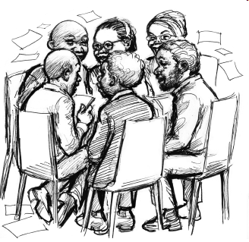
So, WHAT is social accountability and HOW does it contribute to good governance?
“Organized and capable citizens engaging constructively with government to monitor its decisions and actions
toward better delivery of public services, improvement of people’s welfare, and protection of people’s rights.”

Slide 20
Constructive engagement
Citizens groups and government
Evidence- or information-based
Results- or solutions-oriented
Sustained engagement

Slide 21
Monitoring the Public Financial Management (PFM) cycle
Performance monitoring and evaluation
Development planning
Expenditure management
Budget formulation

Slide 22
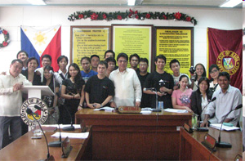
Social accountability tools
Participatory planning:
Naga City People’s Council
Votes and participates in deliberations on design, implementation and evaluation of city projects and programs

Slide 23
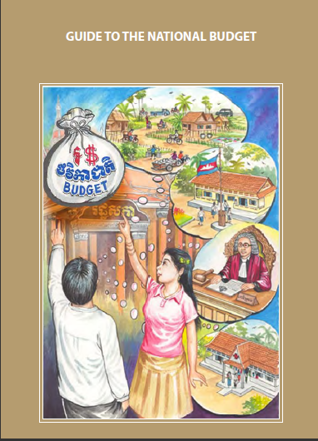
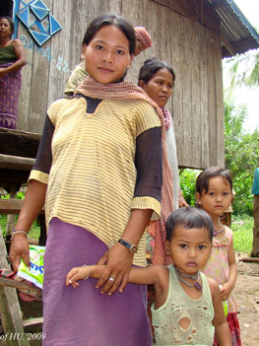
Social accountability tools
Budget monitoring:
NGO Forum in Cambodia
Performed monitoring and analysis of the national budget from 2004 to 2006
Key findings: Share of budget items for “pro-poor” programs have decreased

Slide 24
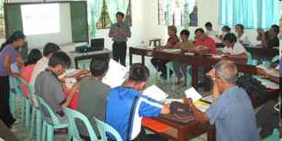
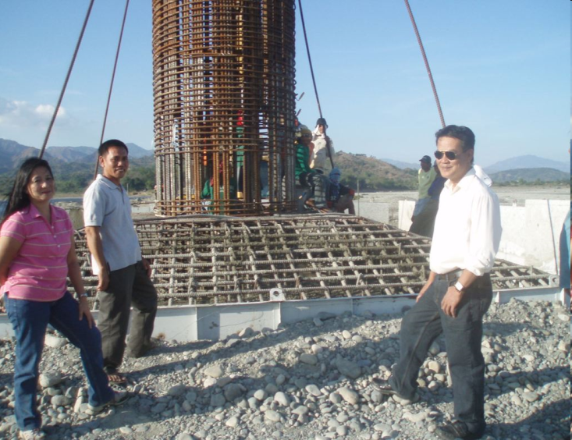
Social accountability tools
Participatory expenditure tracking:
Concerned Citizens of Abra for Good Governance (CCAGG)
CCAGG works out a plan with the concerned government agency to monitor spending on and implementation of infrastructure project

Slide 25
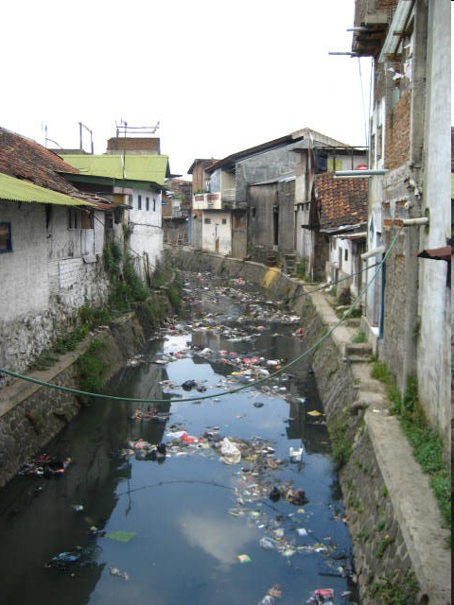
Social accountability tools
Participatory performance monitoring:
Citizen report card - Bandung Institute of Governance Studies (BIGS), Indonesia
Conducted surveys, seminars, focused group discussions with urban poor to measure effectiveness and gender-responsiveness of government’s housing policy.

Slide 26
For constructive engagement and effective citizen monitoring under social accountability to happen …
We need to have the 4 pillars of an enabling environment:
Government openness
Organized and capable citizens
Access to information
Cultural appropriateness

Slide 27
Workshop 2: What we have now? What we can improve?

Slide 28
What do we have now in our barangay in terms of constructive engagement or social accountability? | What can we do to improve what we are doing and enhance constructive engagement and citizen monitoring? | What do we want to achieve in our barangays within the next 6 months? (Goal-setting)

Slide 29
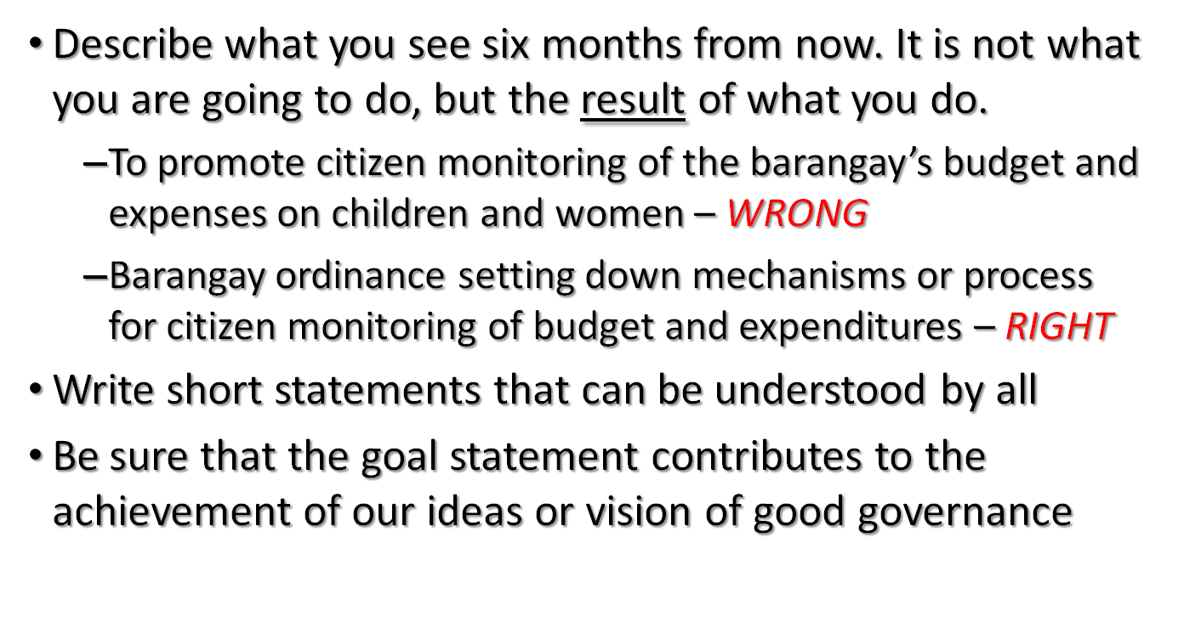

Slide 30
salamat po

